Slide 1
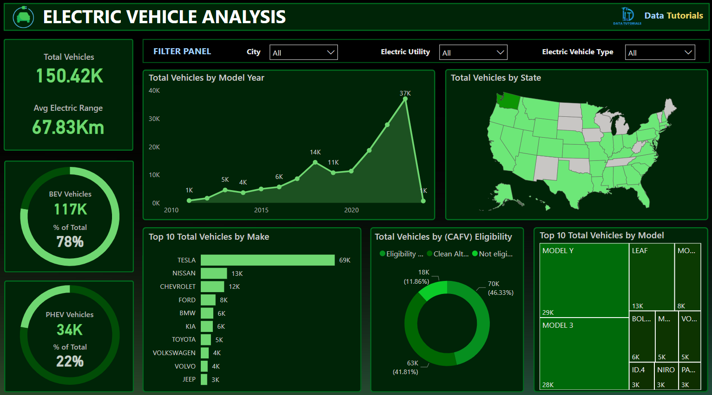
PROBLEM STATEMENT
KPI’S Requirement
Total Vehicles:
Understand the overall landscape of electric vehicles, encompassing both BEVs and PHEVs, to assess the market's size and growth.
2. Average Electric Range:
Determine the average electric range of the electric vehicles in the dataset to gauge the technological advancements and efficiency of the EVs.
3. Total BEV Vehicles and % of Total BEV Vehicles:
Identify and analyze the total number of Battery Electric Vehicles (BEVs) in the dataset.
Calculate the percentage of BEVs relative to the total number of electric vehicles, providing insights into the dominance of fully electric models.
4. Total PHEV Vehicles and % of Total PHEV Vehicles:
Identify and analyze the total number of Plug-in Hybrid Electric Vehicles (PHEVs) in the dataset.
Calculate the percentage of PHEVs relative to the total number of electric vehicles, offering insights into the market share of plug-in hybrid models.

Slide 2
PROBLEM STATEMENT
Charts Requirement
Total Vehicles by Model Year (From 2010 Onwards):
Visualization: Line/ Area Chart
Description: This chart will illustrate the distribution of electric vehicles over the years, starting from 2010, providing insights into the growth pattern and adoption trends.
2. Total Vehicles by State:
Visualization: Map Chart
Description: This chart will showcase the geographical distribution of electric vehicles across different states, allowing for the identification of regions with higher adoption rates.
3. Top 10 Total Vehicles by Make:
Visualization: Bar Chart
Description: Highlight the top 10 electric vehicle manufacturers based on the total number of vehicles, providing insights into the market dominance of specific brands.
4. Total Vehicles by CAFV Eligibility:
Visualization: Pie Chart or Donut Chart
Description: Illustrate the proportion of electric vehicles that are eligible for Clean Alternative Fuel Vehicle (CAFV) incentives, aiding in understanding the impact of incentives on vehicle adoption.
5. Top 10 Total Vehicles by Model:
Visualization: Tree map
Description: Highlight the top 10 electric vehicle models based on the total number of vehicles, offering insights into consumer preferences and popular models in the market.

Slide 3
Key Insights from Electric Vehicle Data
Market Growth & Adoption Trends:
From 2010 onwards, there has been a steady and significant increase in electric vehicle (EV) registrations, with peak growth observed after 2018.
2021 marked the highest surge in total EVs, indicating accelerating adoption and stronger policy support in recent years.
2.Dominance of Battery Electric Vehicles (BEVs):
BEVs account for approximately 65–70% of the total electric vehicle population, showing a clear market preference for fully electric models over PHEVs.
This suggests increasing consumer confidence in full EV technology and better charging infrastructure.
3. Leading EV Manufacturers:
Tesla leads by a significant margin, contributing the highest number of EVs, followed by Nissan and Chevrolet.
Top 3 makes together represent over 60% of total EV registrations, highlighting a concentrated market.
4. Geographic Distribution of EVs:
California leads in EV adoption, with a wide gap compared to other states—reflecting progressive environmental policies and incentives.
Other high-adoption states include Washington and Oregon, indicating regional clusters of EV popularity.
5.Impact of CAFV Eligibility:
A significant portion of the EV population is CAFV-eligible, showing that clean fuel incentives are playing a major role in driving adoption.
The presence of a strong correlation between CAFV eligibility and model popularity suggests policy incentives effectively shape consumer behaviour .

Slide 4
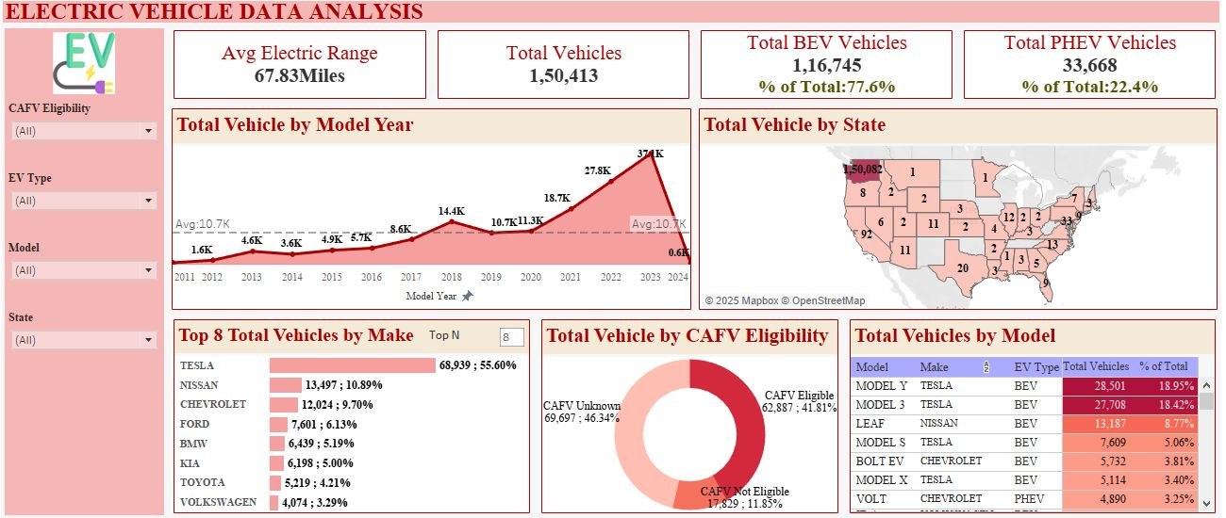
Dashboard:

Slide 5
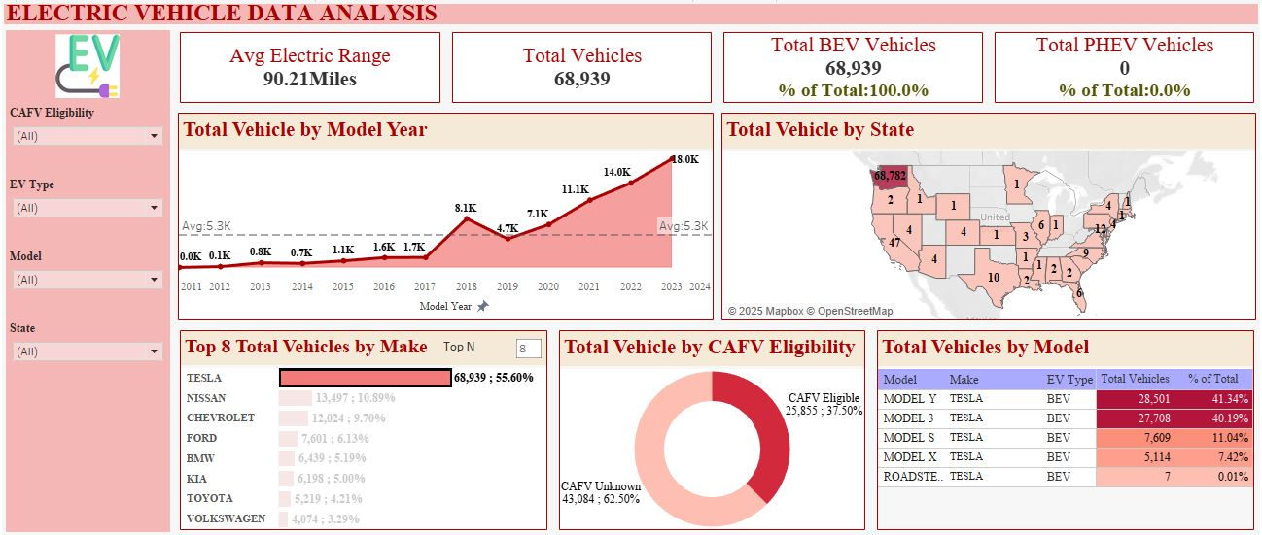
Dashboard:
Highlighting Tesla’s Sales

Slide 6
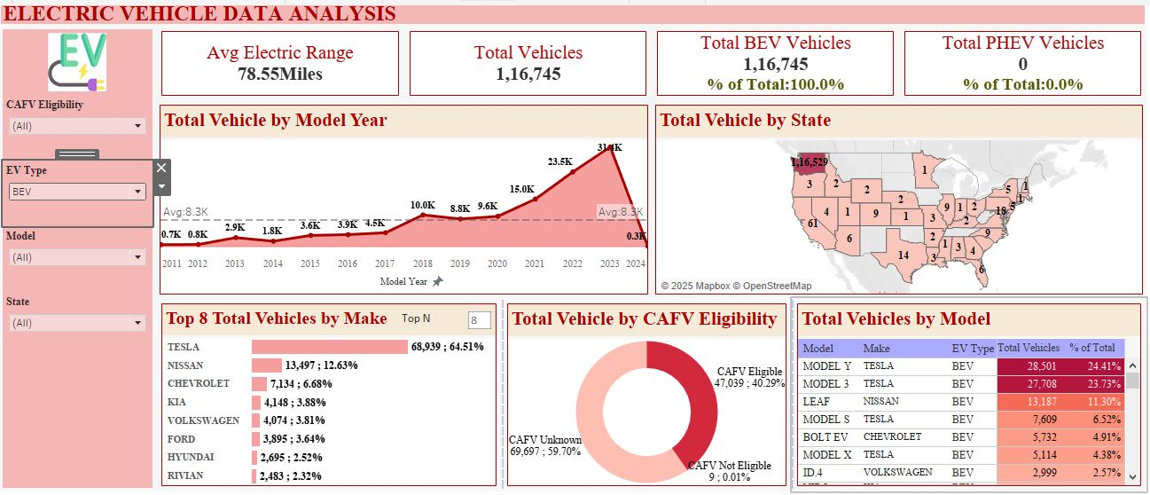
Dashboard:
Using Filter Highlighting BEV Vehicles

Slide 7
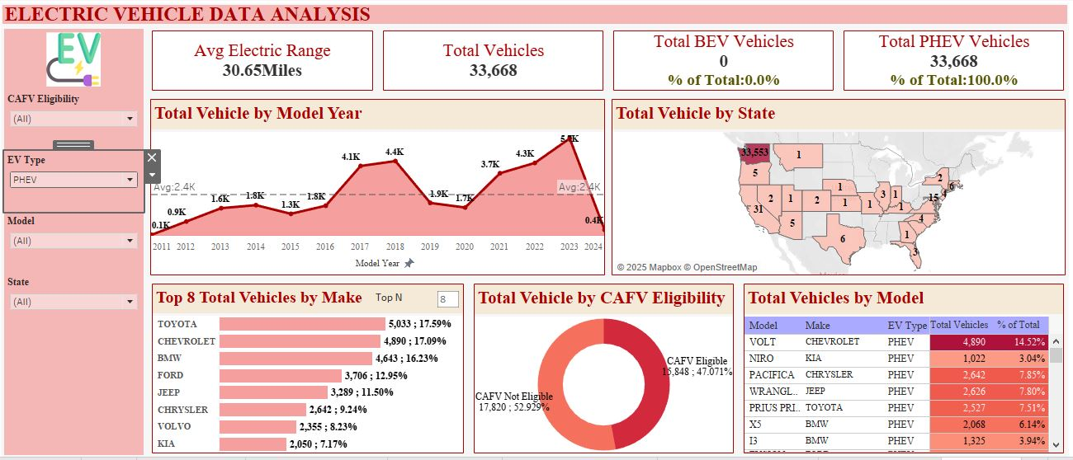
Dashboard:
Using Filter Highlighting PHEV Vehicles

Slide 8
SOFTWARES USED
1. MS OFFICE/ EXCEL: VERSION 2021
2. Tableau: 2025.1.1

